Slide 1
12-LEAD ECG ABNORMALITY IDENTIFICATION
USING ML/DL
ScaleMind - Nguyen Phuong Linh, Hoang Minh Thao

Slide 2
TABLE OF CONTENT
1
2
3
New knowledge
& Papers
Achievement
Next intention

Slide 3
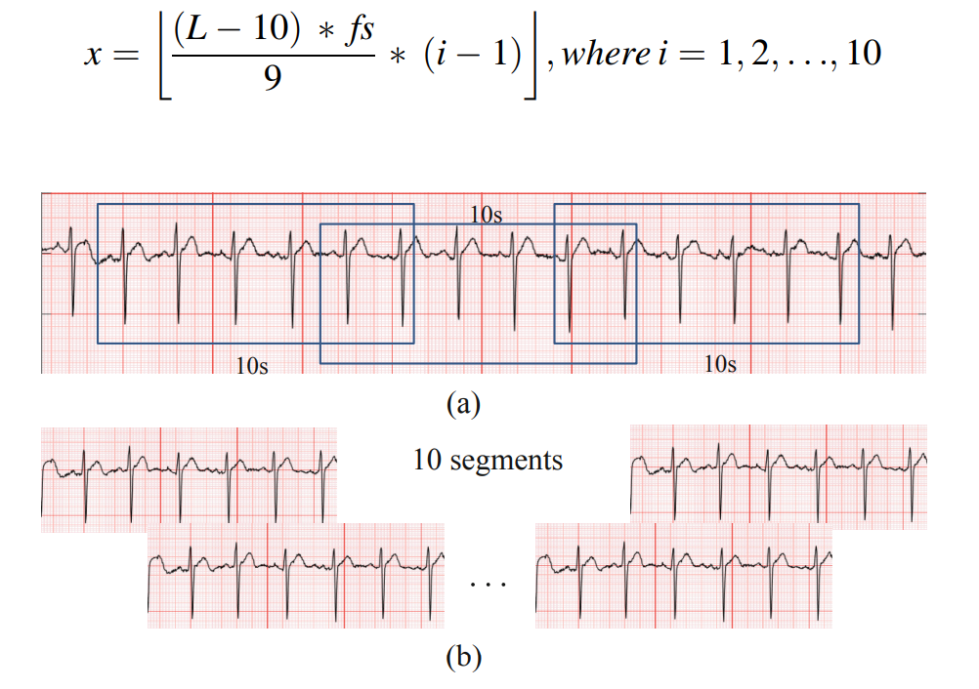
New knowledge & paper
Paper
A 12-Lead ECG Arrhythmia Classification Method Based on 1D Densely Connected CNN
Year: 2019
Authors: Chunli Wang , Shan Yang , Xun Tang , and Bin Li
Dataset: FCEIC, 6500 12-lead ECG records, length 9-91s
Methods:
Data augmentation: wavelet-based shrinkage filtering (db4, db6, symlet 8)
Data segmentation: break each record into 10 segments with fixed length 10s.
Data segmentation

Slide 4
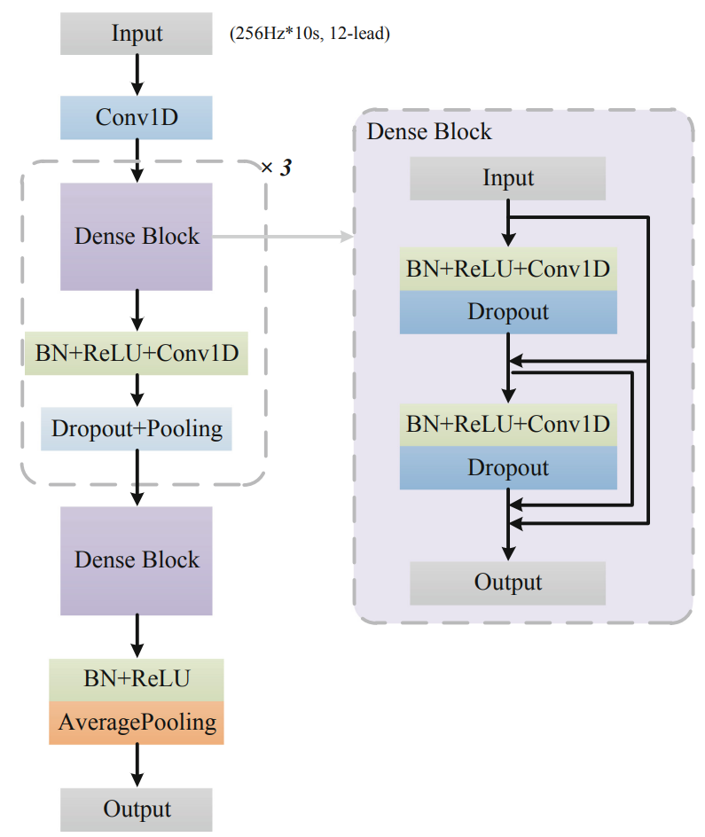
New knowledge & paper
Paper
A 12-Lead ECG Arrhythmia Classification Method Based on 1D Densely Connected CNN
Methods:
Model Architecture and Training:
1D Densely Connected CNN
model architecture of 1D densely connected CNN

Slide 5
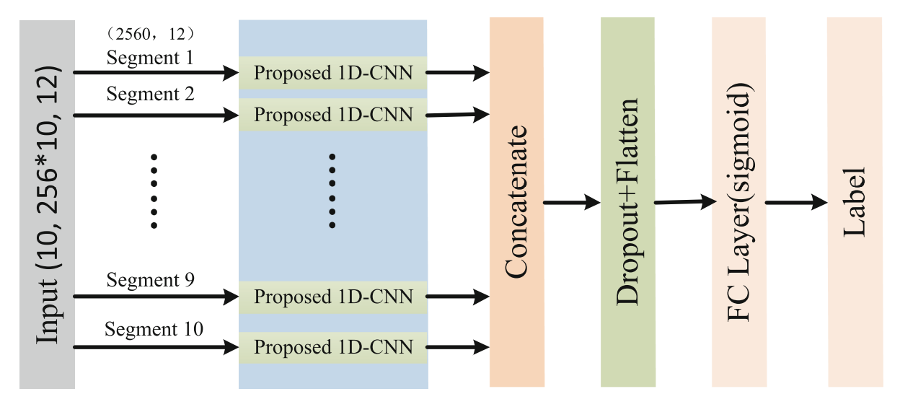
New knowledge & paper
Paper
A 12-Lead ECG Arrhythmia Classification Method Based on 1D Densely Connected CNN
Methods:
Model Architecture and Training: 1D Densely Connected CNN
Architecture of proposed network

Slide 6
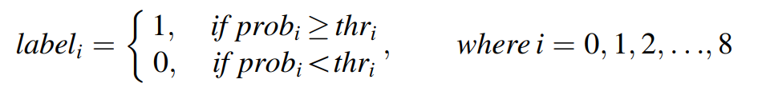
New knowledge & paper
Paper
A 12-Lead ECG Arrhythmia Classification Method Based on 1D Densely Connected CNN
Methods:
Model Architecture and Training: 1D Densely Connected CNN
Multi-label Classification:
Fit the neural network to perform multi-label classification by replacing the final softmax layer with a sigmoid layer and then using Binary Cross Entropy to optimize the model.
A threshold vector was trained for the multi-label classification since each record may have more than one abnormal types. The threshold vector was calculated to achieve the highest Matthews correlation coefficient on the training set.

Slide 7
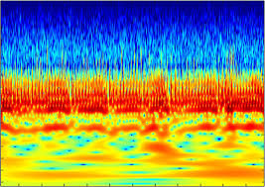
New knowledge & paper
New knowledge
Wavelet transform:
Common approach to preprocess signal (ECG, EEG)
Better than Fourier Transform
Has python package: PyWavelets
Scaleogram
Visual method of displaying a wavelet transform
Plot tool for 1D data analysis with Continuous Wavelet Transform built on the PyWavelets library
s
t

Slide 8
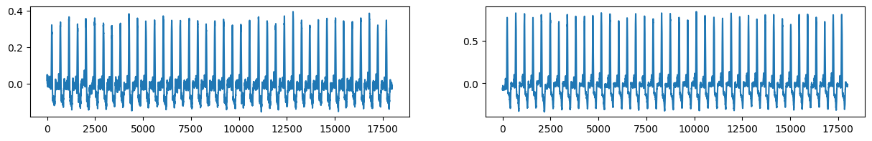
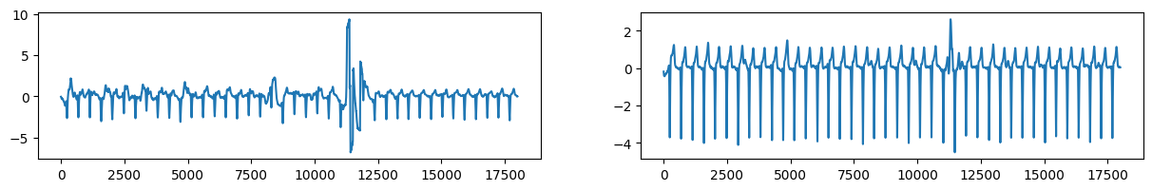
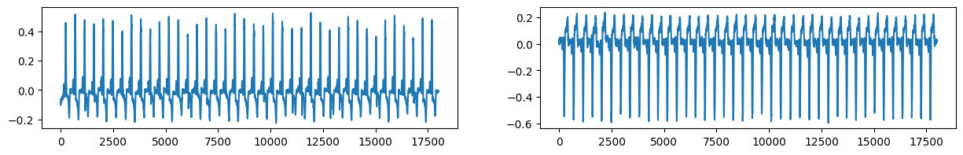
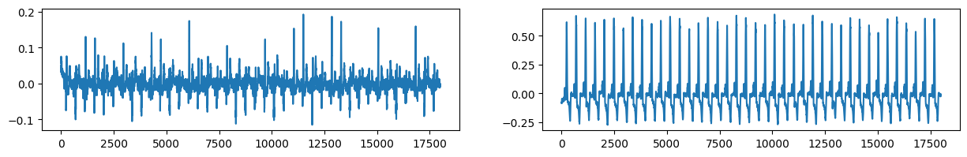
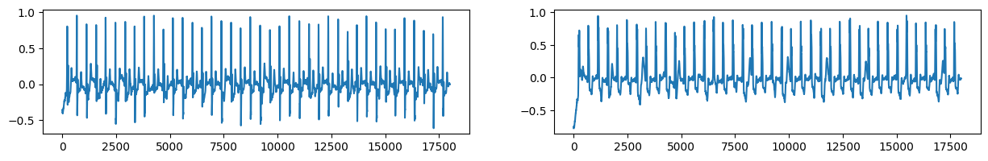
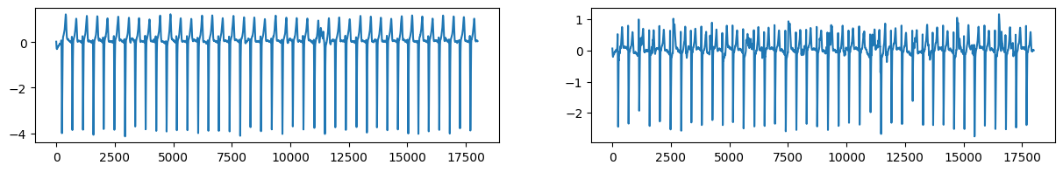
ACHIEVEMENTS
Data exploring
6877 recordings of 12-lead ECG lasting from 6s to 60s.
~4500 numbers correspond to 10s.
~400 numbers correspond to one heartbeat
Labels are provided for each recording.

Slide 9
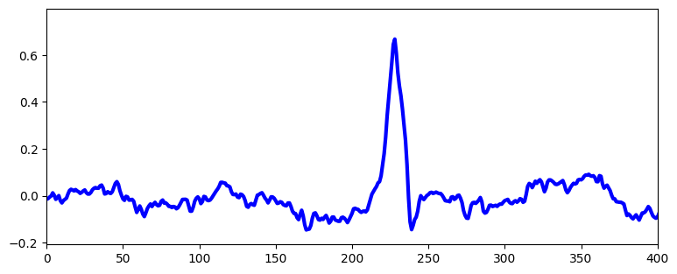
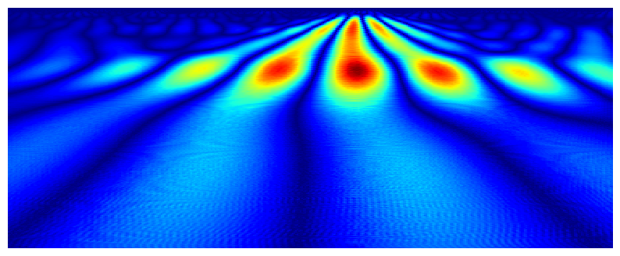
ACHIEVEMENTS
Data preprocessing
Part of original signal
Morlet wavelet transform
Make scaleogram
Length 400

Slide 10
NEXT INTENTION
Research more ways to segment data
Segment data
Research models to train data

Slide 11
THANKS!

